Slide 1
DESIGNING AND MODELLING
TRANSITION DAY

Slide 2
TASK
Design 2 different clock ideas and model one of your idea.

Slide 3
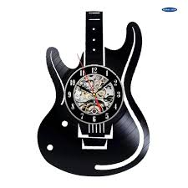
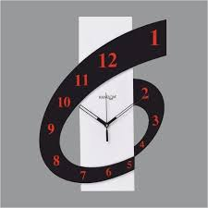
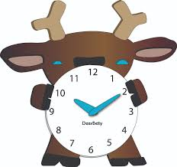
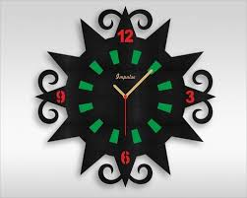
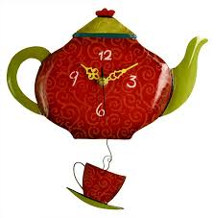
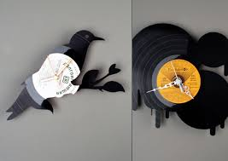
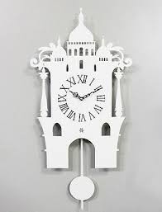
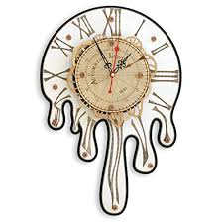
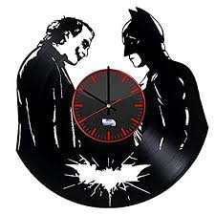
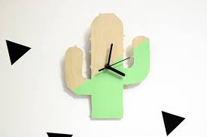
EXAMPLE CLOCK DESIGNS

Slide 4
TASK: Design 2 clock ideas
Idea 1
4

Slide 5
TASK: Design 2 clock ideas
Idea 2
5

Slide 6
Purpose of Modelling
TESTING
IDENTIFICATION OF FAULTS
DESIGN IMPROVEMENTS IDENTIFIED
CUSTOMER / CLIENT DISCUSSIONS
SAFETY ISSUES / EVVIRONMENTAL ISSUES
ASSESSING MATERIALS
EVALUATE FUNCTIONALITY
ASSESSING AESTHETICS
ASSESSING ERGONOMICS
USED WITH FOCUS GROUP
SAVES MONEY
Notes:
http://www.youtube.com/watch?v=s1R4R8stwI8
6

Slide 8
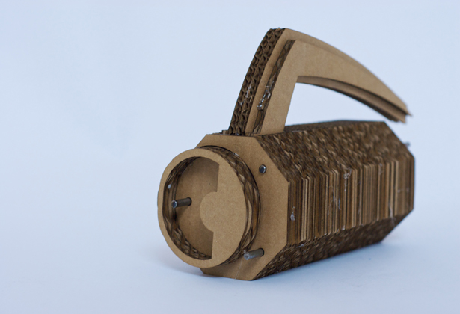
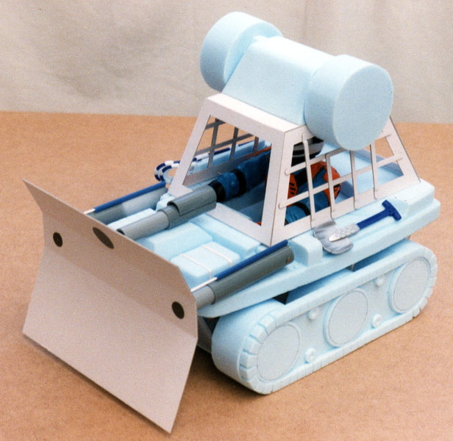
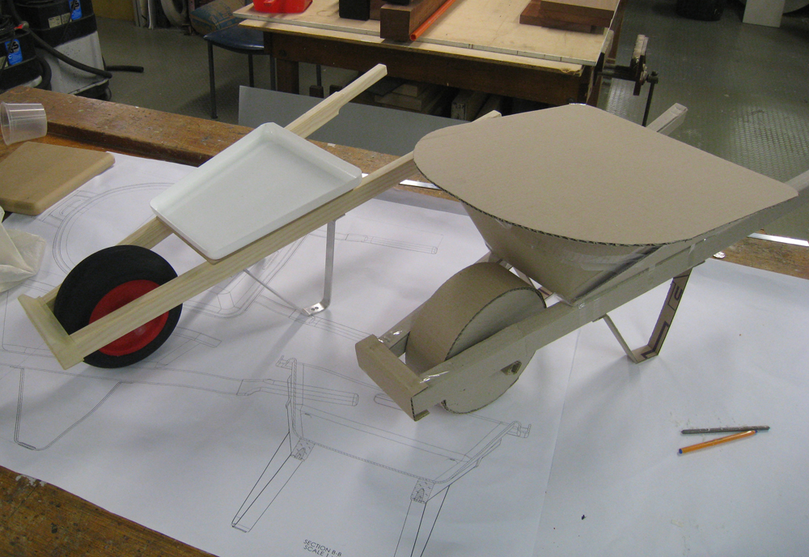
EXAMPLE MODELS
Notes:
http://www.technologystudent.com/prddes1/mod1.html
http://www.technologystudent.com/prddes1/prototype1.html
http://www.bbc.co.uk/schools/gcsebitesize/design/graphics/materialsandcomponentsrev5.shtml
8

Slide 9
Model one of your clock idea (Use card or paper)
9

Slide 10
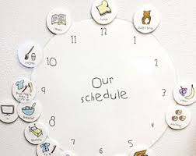
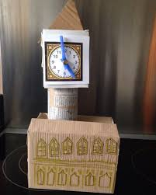
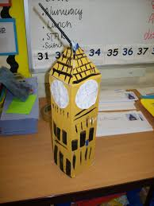
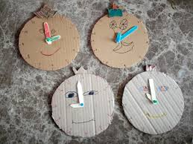
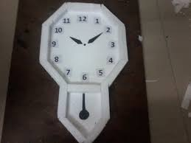
EXAMPLE CLOCK MODELS

